Slide 1
Kinetic Energy

Slide 2
Understand kinetic energy in terms of speed, distance and time.
Define kinetic energy.
Define mechanical energy.
Relate kinetic energy to speed.
Identify the standard units for speed, distance and time.
Use the equation speed = distance / time
Apply the equation above in real life situations, such as speed limits and paper planes.

Slide 3

Mechanical Energy
An object that is moving is said to have kinetic energy, but it also has potential energy. Therefore it is best to describe an object in motion as having mechanical energy.

Slide 4
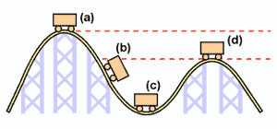
Mechanical energy
Mechanical energy is the sum of an objects potential energy and kinetic energy.
Examples of mechanical energy include a roller coaster, skateboarder, an arrow flying through the air, a weight lifter and aanything in motion.

Slide 5
Kinetic Energy
Kinetic energy is the energy possessed by a moving object
We measure kinetic energy in joules
MAKE THE CONNECTION

Slide 6
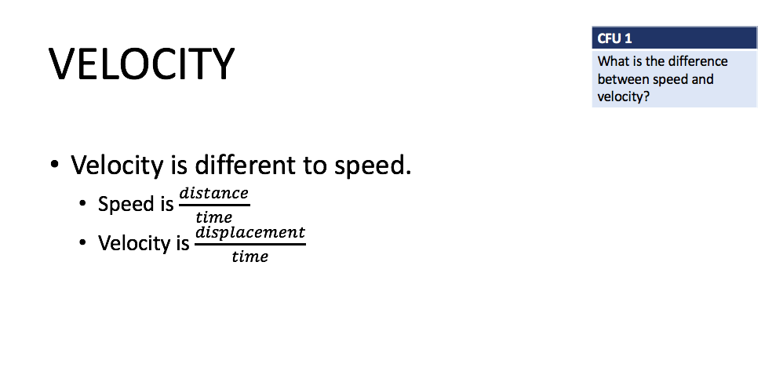
MAKE THE CONNECTION

Slide 7
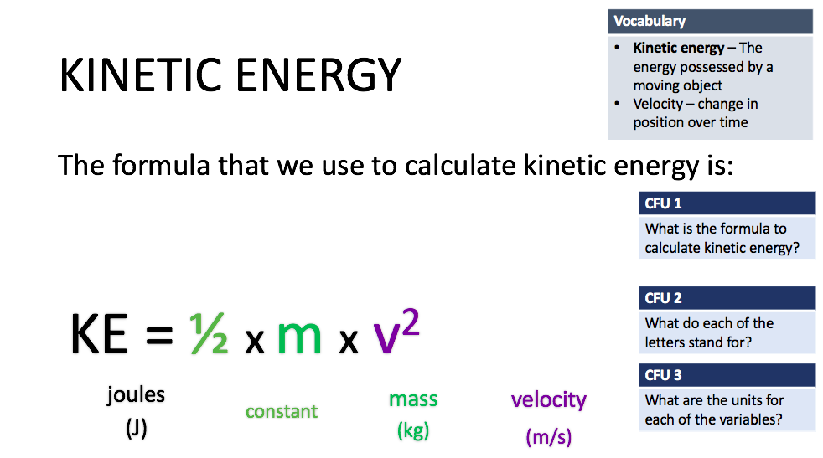
DEFINITION

Slide 8
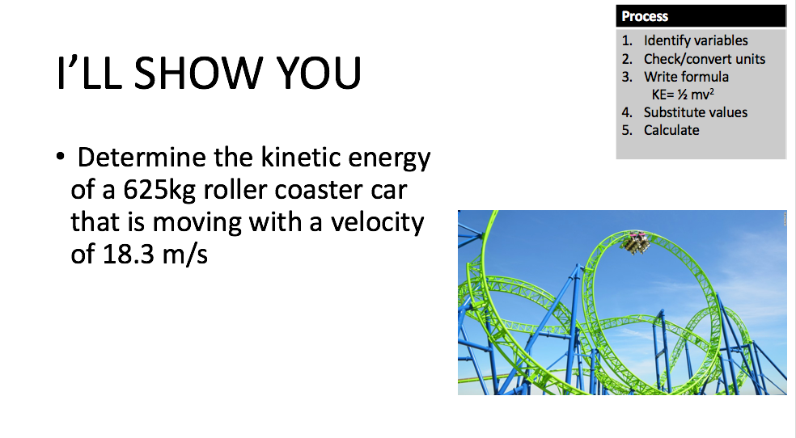
DEFINITION

Slide 9
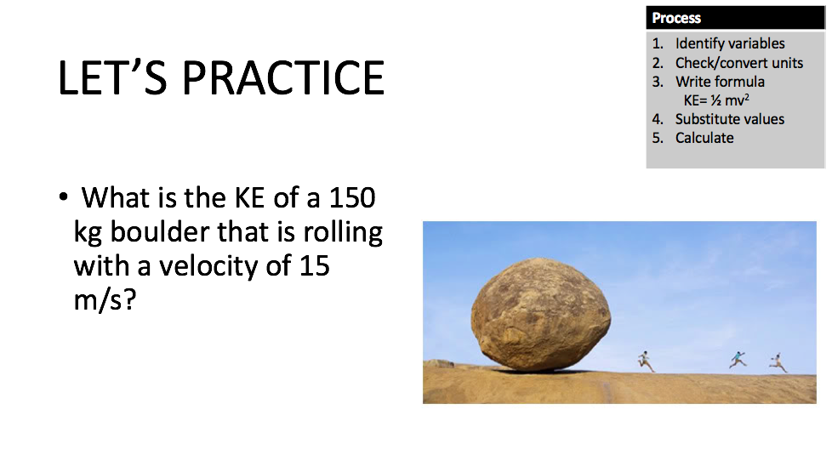
DEFINITION

Slide 10
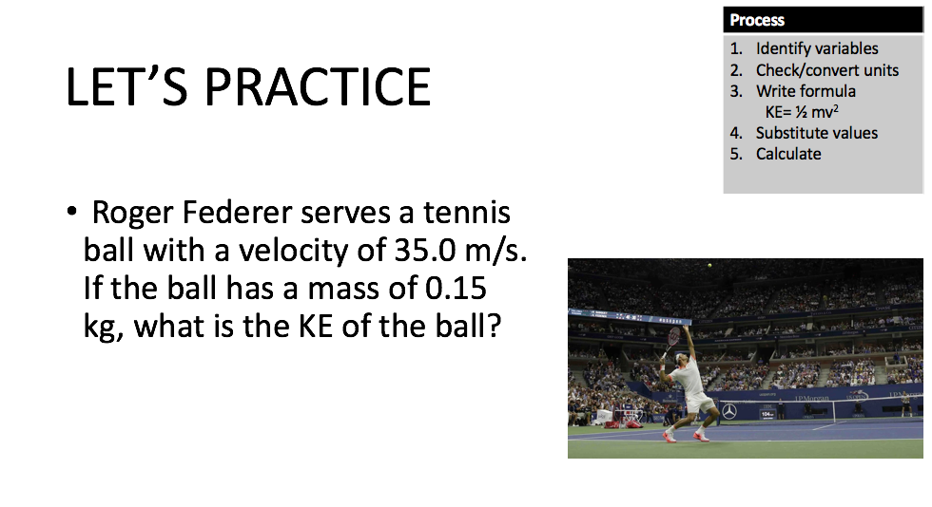

Slide 11
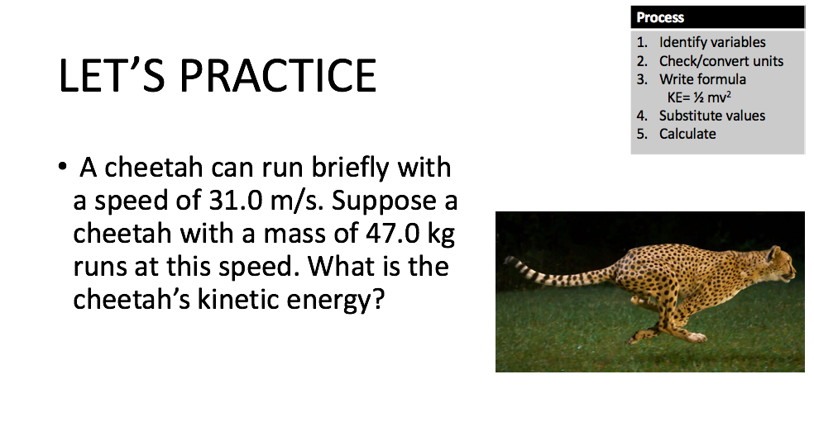

Slide 12
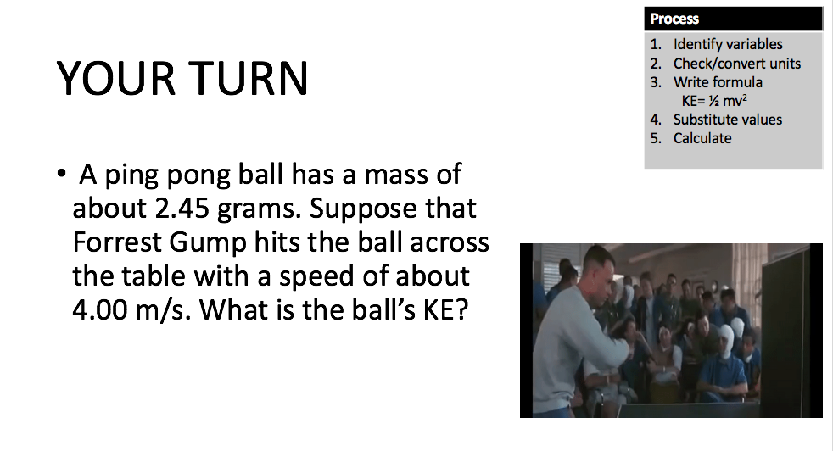

Slide 13
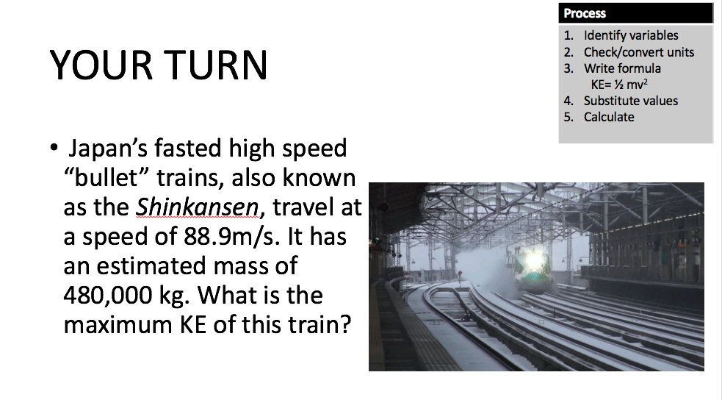

Slide 14
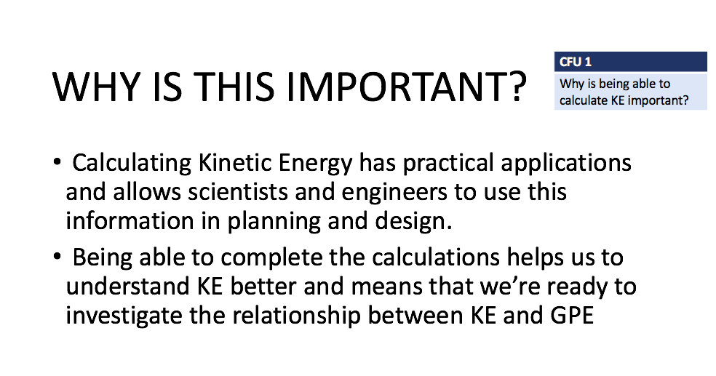

Slide 15
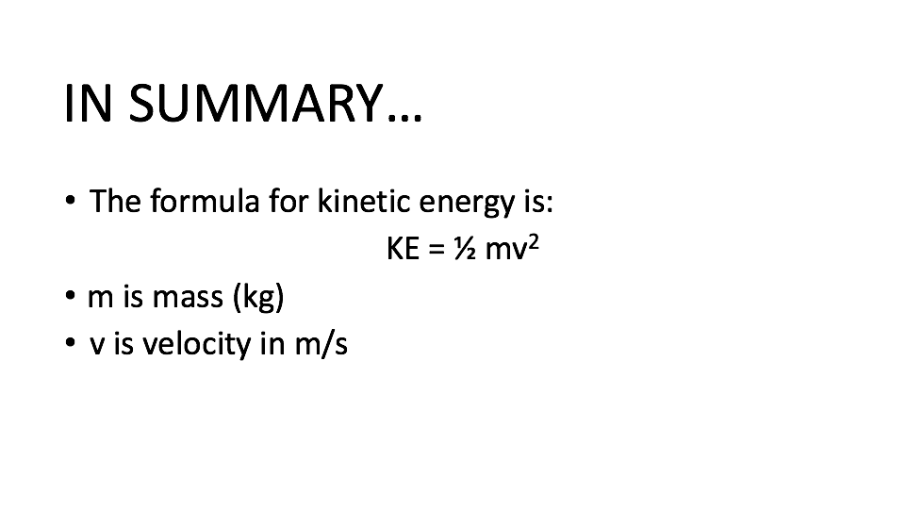

Slide 16
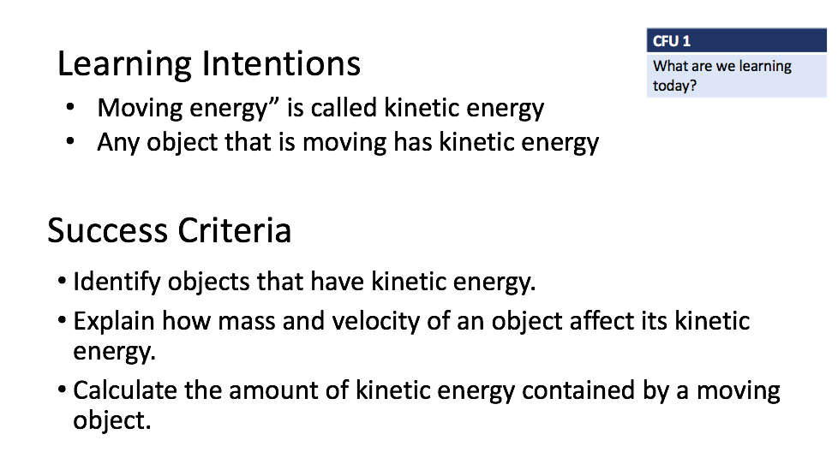
TRACK WITH ME
READ WITH ME
DEFINITION
Define a key word in the learning objective here.
DECLARE THE OBJECTIVE
Read the learning objective to your partner.
Notes:
Learning Objectives contain concepts (nouns, big ideas), skills (verbs, measurable behaviours) and sometimes context (restricting or targeting conditions).
●Example: Students will be able to describe the concept of density and apply it to floating and sinking.
Success criteria are specific measurable outcomes that if met mean that the student has met the learning objective.
Examples:
•Students will be able to compare densities of substances using mass and volume.
•Students will be able to identify whether a solid or liquid will float or sink in a liquid based on their densities.

